Slide 1
FCFS Scheduling Simulator Using HTML, CSS, and JavaScript
Members:
Princess Abegail D. Benitiz
Leila Mae C. Cajes
Carl Anthony Astillo
Aliaza Leoligao
Gabriel Latojao
Angel Boncales
Clark Magdadaro
Jhon Philip Padillo
Nova Jessica Y. Cuizon
Pamela Camacho
Elmer Roble

Slide 2
Table of Contents
Introduction
Objectives
Technologies Used
FCFS Scheduling Algorithm
Working Principle
System Design
Features of the Project
Formula Used
Implementation Details
Gantt Chart Explanation
Sample Input and Output
Advantages and Disadvantages
Challenges Faced
Future Improvements
Conclusion

Slide 3
Introduction
The FCFS Scheduling Simulator is a web-based application developed to simulate the First Come First Serve (FCFS) CPU scheduling algorithm used in Operating Systems.
The simulator helps users understand how processes are executed according to their arrival time. It provides visual representation through a Gantt Chart and calculates important scheduling parameters such as:
Completion Time
Waiting Time
Turnaround Time
Average Waiting Time
Average Turnaround Time
The project is developed using:
HTML
CSS
JavaScript

Slide 4
Objectives
The objectives of this project are:
To understand FCFS CPU scheduling
To simulate process execution visually
To calculate scheduling parameters
To create an interactive scheduling environment
To improve understanding of Operating System concepts

Slide 5
Technologies Used
Technology | Purpose
HTML | Structure of webpage
CSS | Styling and design
JavaScript | Logic and calculations

Slide 6
FCFS Scheduling Algorithm
FCFS stands for First Come First Serve.
It is the simplest CPU scheduling algorithm where:
The process that arrives first gets executed first.
Processes are executed in queue order.
Once a process starts execution, it runs until completion.
FCFS is a non-preemptive scheduling algorithm.

Slide 7
Working Principle
The project consists of three major components:
Frontend
Developed using HTML and CSS for:
User interface
Tables
Buttons
Gantt Chart design
Logic Processing
JavaScript handles:
Process sorting
FCFS calculations
Dynamic updates
Visualization
The Gantt Chart displays:
Process execution order
Start time
Completion time

Slide 8
Features of the Project
Add Process
Users can dynamically add multiple processes.
Input Fields
Users enter:
Arrival Time
Burst Time
FCFS Calculation
Calculates:
Completion Time
Waiting Time
Turnaround Time
Dynamic Result Table
Displays calculated scheduling results.
Gantt Chart
Provides visual execution representation.
Average Calculations
Displays:
Average Waiting Time
Average Turnaround Time

Slide 9

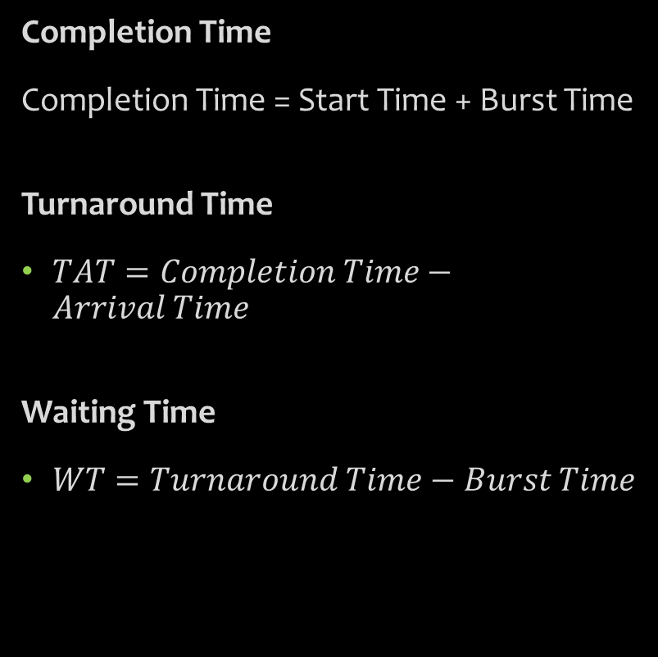
Formula Used
Completion Time
Completion Time = Start Time + Burst Time
Turnaround Time
$TAT=Completion Time−Arrival Time$
Waiting Time
$WT=Turnaround Time−Burst Time$
Average Waiting Time
$Average WT=\frac{Total Waiting Time}{Number of Processes}$
Average Turnaround Time
$Average TAT=\frac{Total Turnaround Time}{Number of Processes}$

Slide 10
Implementation Details
HTML
Used to create:
Tables
Input fields
Buttons
Containers
CSS
Used for:
Background images
Styling
Responsive design
Gantt chart formatting
JavaScript
Used to:
Read input values
Sort processes
Calculate scheduling data
Generate Gantt chart dynamically

Slide 11
Gantt Chart Explanation
The Gantt Chart visually represents CPU scheduling.
Each block in the chart shows:
Process name
Execution duration
Start time
Completion time
Larger burst times create larger blocks.
The chart improves understanding of process execution order.

Slide 12
Sample Input and Output
Sample Input
Process | Arrival Time | Burst Time
P1 | 4 | 12
P2 | 7 | 5
Sample Input
Process | Completion | Turnaround | Waiting
P1 | 16 | 12 | 0
P2 | 21 | 14 | 9
Average Values
Average Waiting Time = 4.5
Average Turnaround Time = 13

Slide 13
Advantages and Disadvantages
Advantages
Simple and easy to implement
Fair according to arrival order
Easy visualization
Disadvantages
Long waiting time possible
Convoy effect may occur
Not efficient for short processes

Slide 14
Challenges Faced
During development, the following challenges were faced:
Dynamic table row generation
Gantt chart spacing
Correct scheduling calculations
Responsive design issues
Process sorting implementation

Slide 15
Conclusion
The FCFS Scheduling Simulator successfully demonstrates the working of the FCFS CPU scheduling algorithm.
The project helps users understand:
CPU Scheduling
Process execution
Waiting time calculation
Turnaround time calculation
Gantt Chart visualization
The simulator is interactive, educational, and useful for Operating System learning.

Slide 16
Thank
You!😊

